Slide 1
Module 6

Slide 2

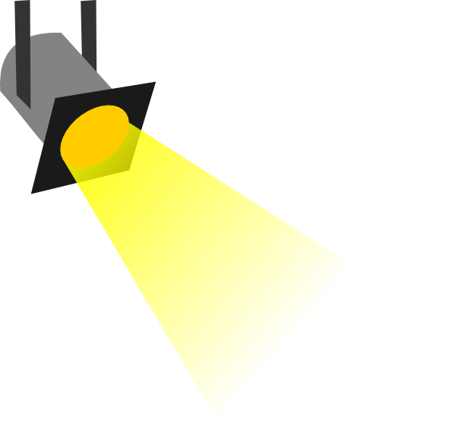
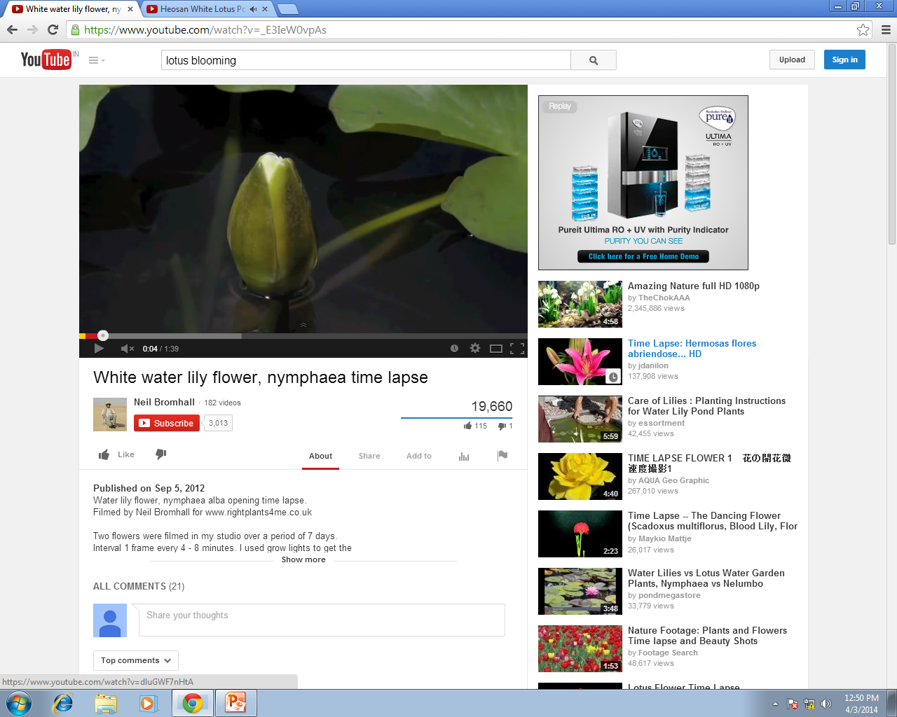
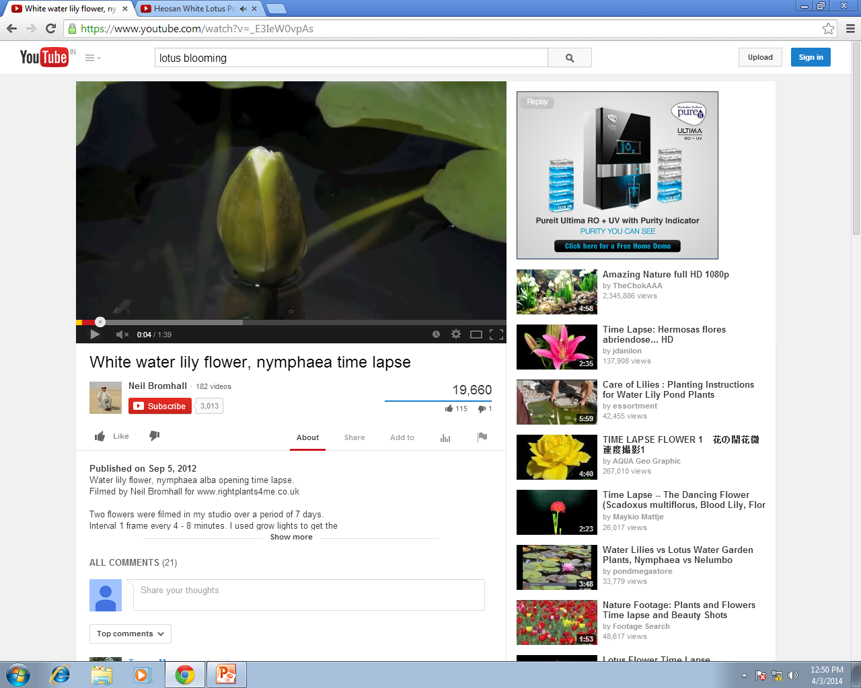
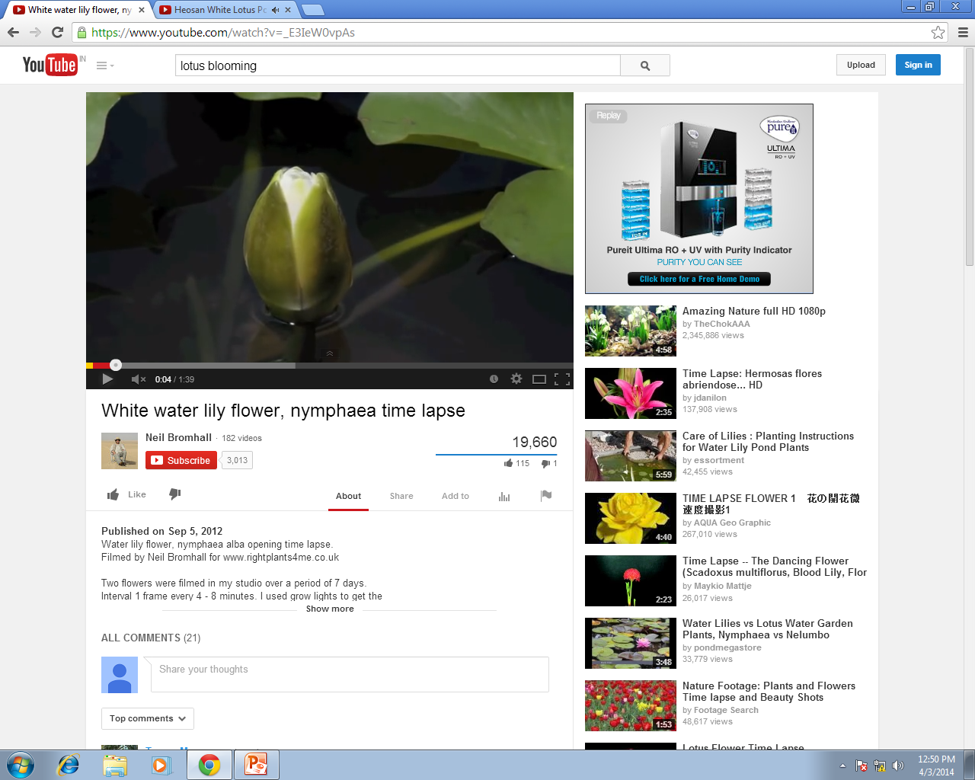
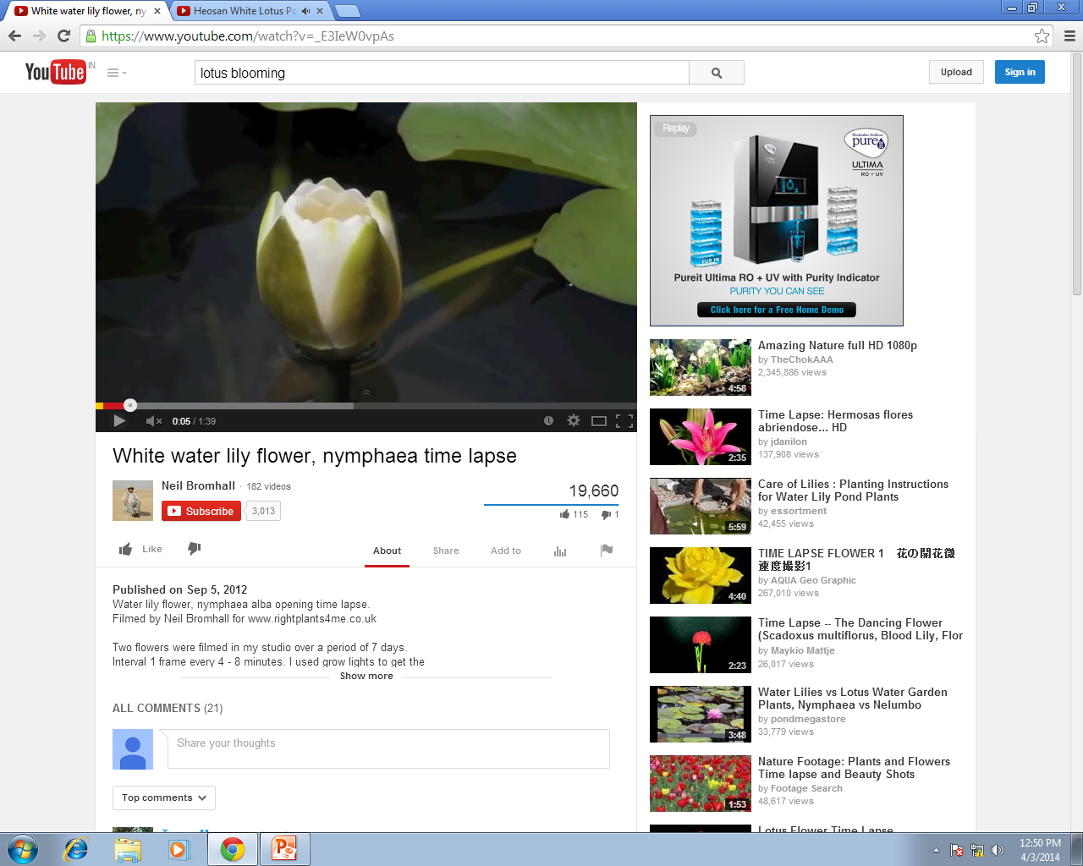
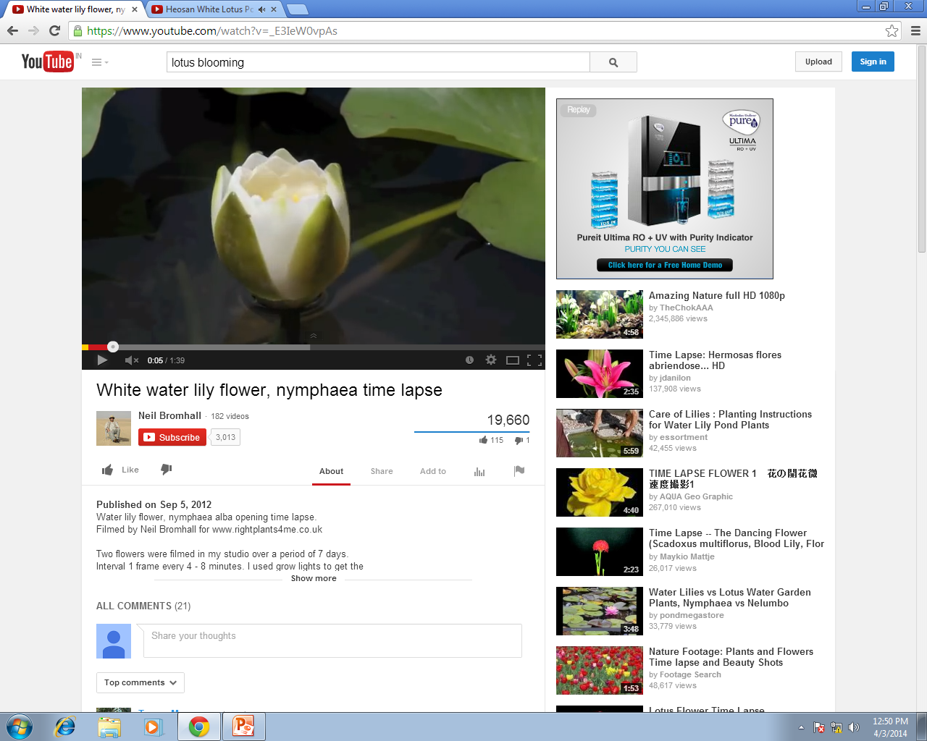
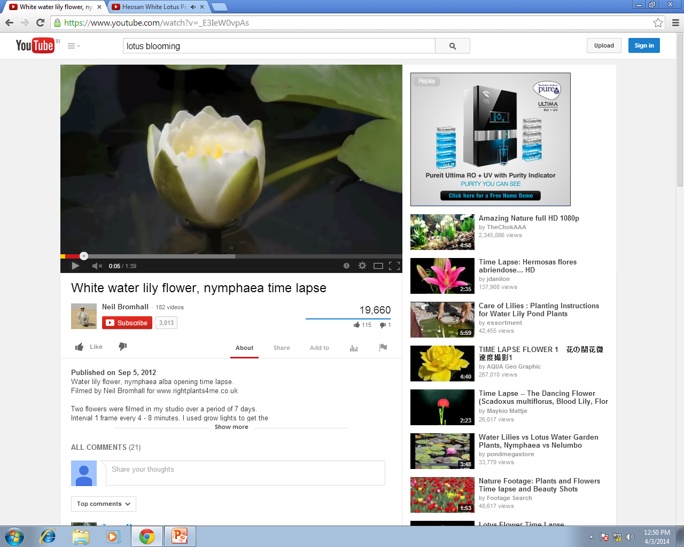
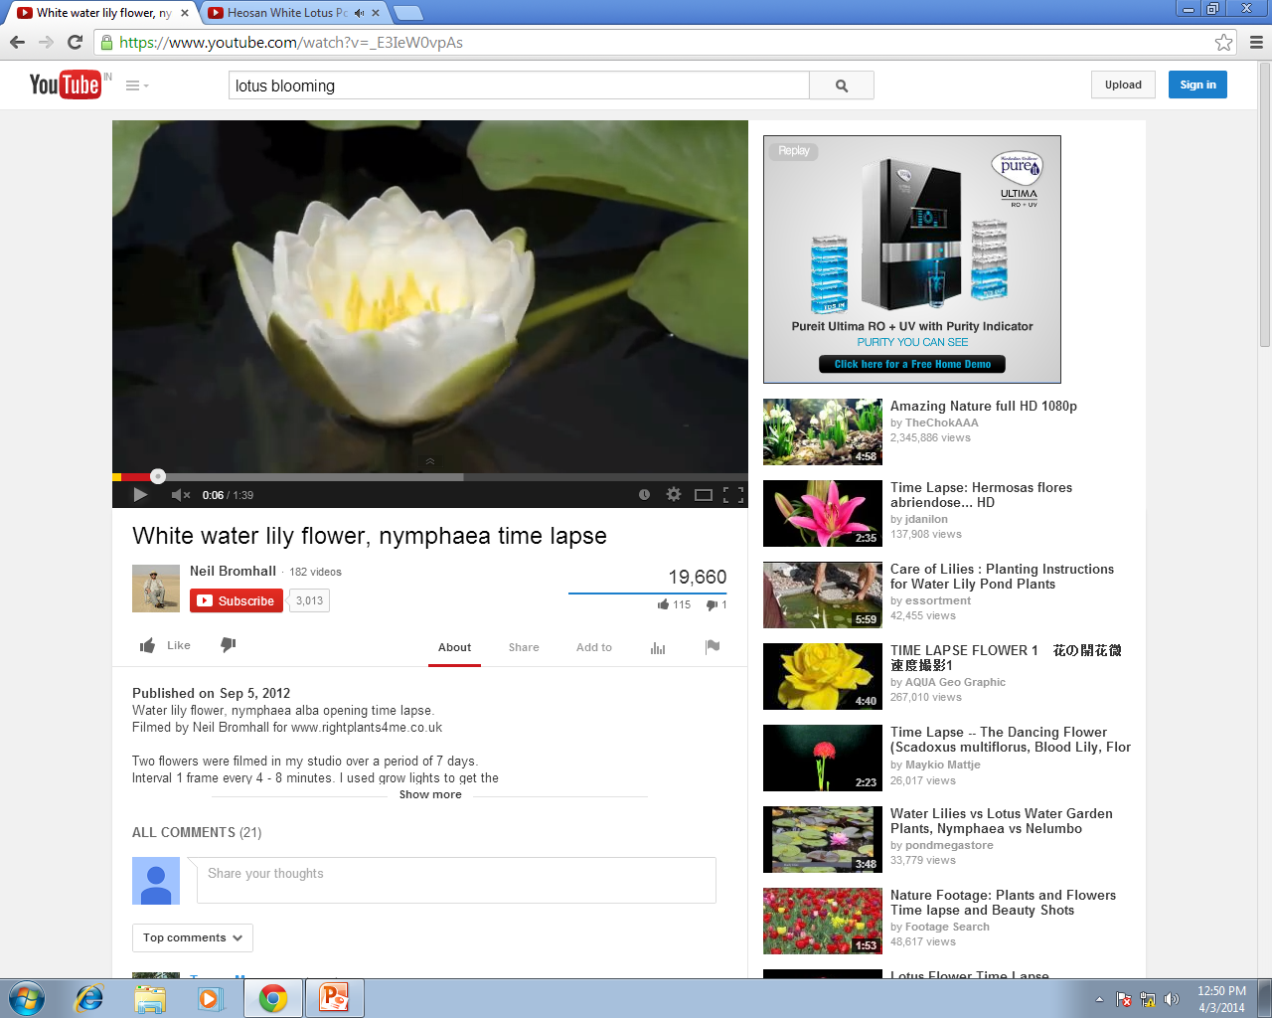
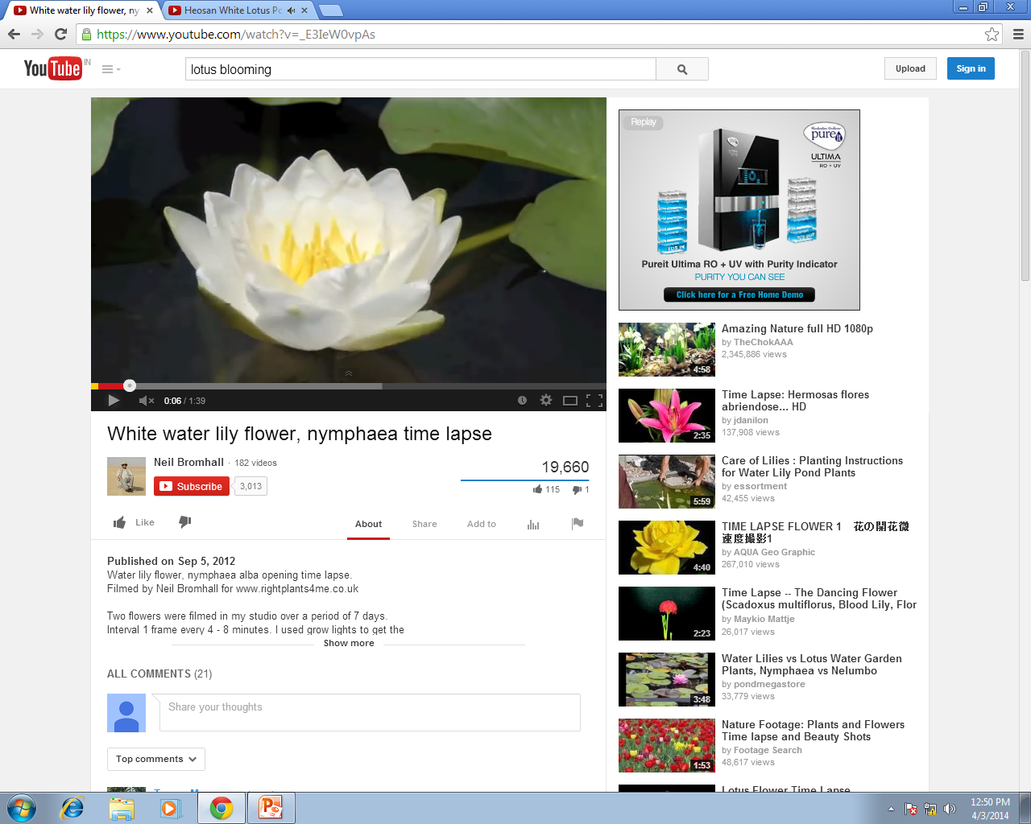
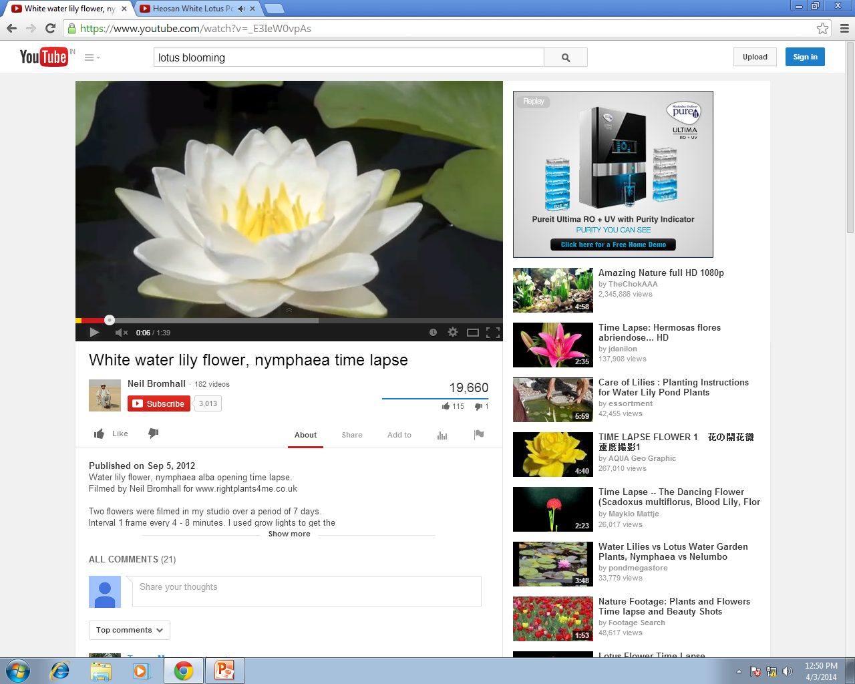




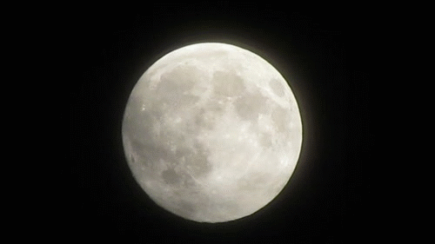
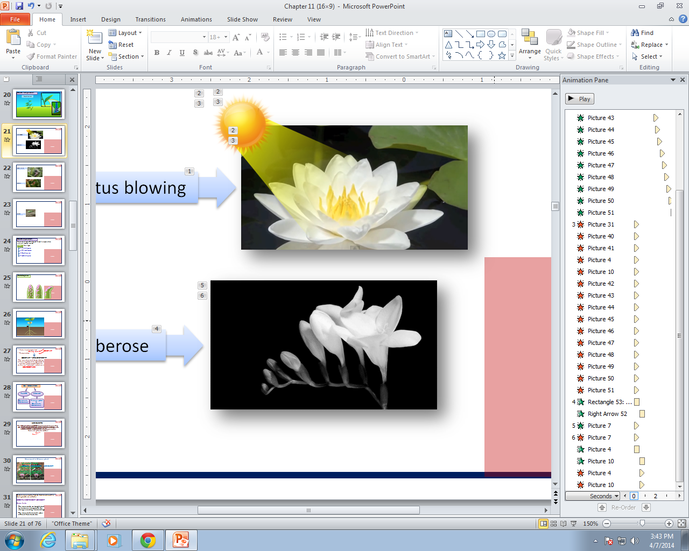
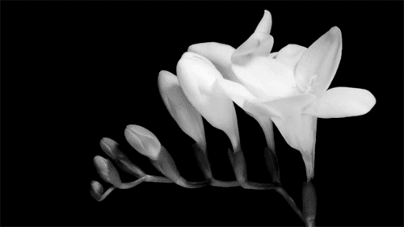
Some examples of growth independent movements
Stimulus is Light
Lotus blooming
In response lotus opens in the morning
Stimulus is absence of Light
In response Tuberose opens at night
Tuberose

Slide 3
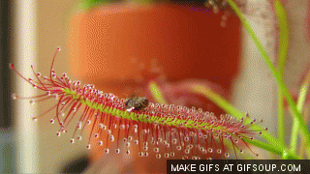
Stimulus is touch of an insect
Drosera
Insect eating
In response insectivorous plants like Drosera curl inwards to trap the insect

Slide 4
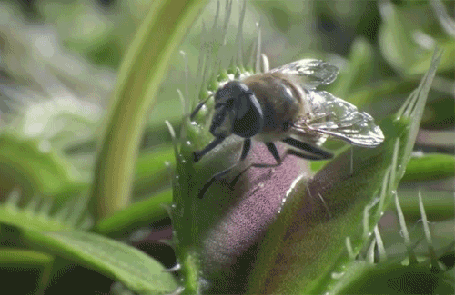
Venus flytrap
Venus flytrap looks and smells like a flower to the insects
Stimulus is touch of an insect to the trigger hair
In response Venus flytrap shuts and digests the insect

Slide 5
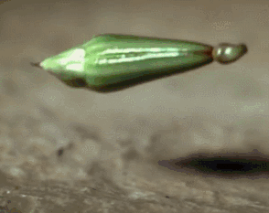
Fruit of balsam
In response explosive fruit of balsam plant bursts open at appropriate time to scatter the seeds
Stimulus is touch

Slide 6
Thank You

